Slide 1
IT437-Quantum Computing
END-SEM PROJECT EVALUATION

Slide 2
PROJECT MEMBERS
SALIQ GOWHAR KHAN
BHAVYA
ASHUTOSH KUMAR GUPTA
211AI043
211AI011
211AI008

Slide 3
Efficient data encoding and decoding for quantum computing

Slide 4

PROJECT INSIGHTS

Slide 5
Introduction and motivation
Various Quantum computing tasks require efficient Classical to Quantum encoding of data as well as Quantum Classical encoding, with allowable circuit depths as well as the number of qubits. Existing state synthesis and de-synthesis methods face challenges in either of the two conditions mentioned above, especially for Q2C where existing methods include repeated sampling of quantum circuits, causing a huge overhead in overall execution time. Hence we require time and resource-efficient methods for both C2Q and Q2C transformation of data.

Slide 6
PROBLEM STATEMENT
To create a system capable of efficiently encoding and decoding images on quantum systems with reduced circuit depths to minimize decoherence.

Slide 7
objectives
To efficiently implement Classical to Quantum data encoding for images with minimal circuit depths and circuit complexity using the Flexible Representation of Quantum Images (FRQI) technique.
To efficiently implement Quantum to Classical data decoding technique for images using the Quantum Haar wavelet transform with a one-stage parallel pyramidal QHT circuit.
To analyze the efficiency of our algorithms and compare them with other available techniques.

Slide 8
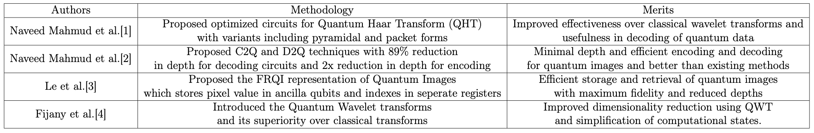
Summary of Literature Survey
.

Slide 9
Proposed methodology
Dataset analysis: We utilize RGB images of sizes 2×2, 4×4, 8×8, 16×16, and 32×32. As a pre-processing step, we convert the images to greyscale and normalize the pixel values by dividing each value by 255. Then, we multiply each intensity value by π/2 to convert them into Θ values for FRQI encoding. This multiplication accounts for the rotation gates in FRQI, ensuring a maximum rotation of 180 degrees.

Slide 10
Proposed methodology
C2Q Encoding utilizes the FRQI technique to represent image coordinates and color information in quantum states. FRQI focuses on efficient image processing and compression. The FRQI state is obtained through unitary operations involving Hadamard and controlled rotation gates. The process requires 2n Hadamard gates and 2^2n controlled rotations, which can be implemented using C2^nRy(2Θ) and NOT operations. However, the large number of gates needed for FRQI can be reduced through Quantum Image Compression. FRQI offers a novel approach to representing images on quantum computers by storing color and position data in quantum states.

Slide 11
Proposed methodology
Q2C decoding involves utilizing the Quantum Haar Transform (QHT), a specific type of wavelet transform. The QHT preserves local data characteristics in both space and time and can be decomposed into multiple levels. This decomposition allows for reducing the number of qubits required for data representation, thereby minimizing measurement time. In our proposed Q2C method, we employ the optimized 1-stage parallel Quantum Haar Transform circuit, denoted as Ud-D-QHTpar, opt, which minimizes circuit depth. By adopting the pyramidal decomposition approach, we can decrease the number of qubits needed and reduce the circuit depth after each decomposition level. This approach offers advantages in terms of efficiency and resource utilization.

Slide 12

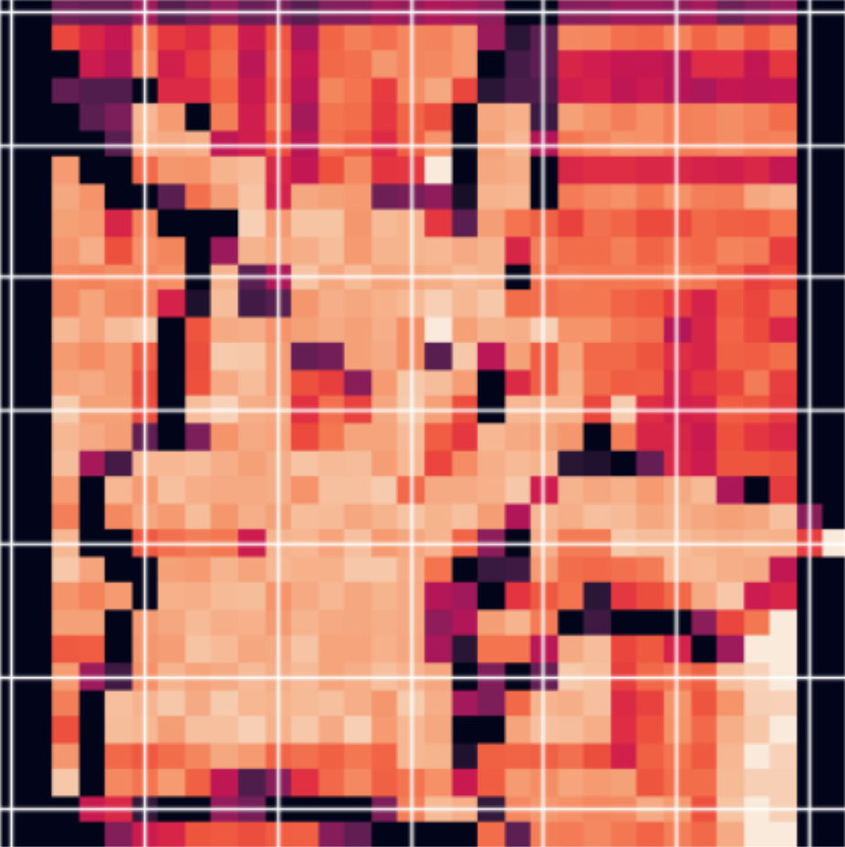
RESULT AND ANALYSIS
.
Input Image
Output Image

Slide 13
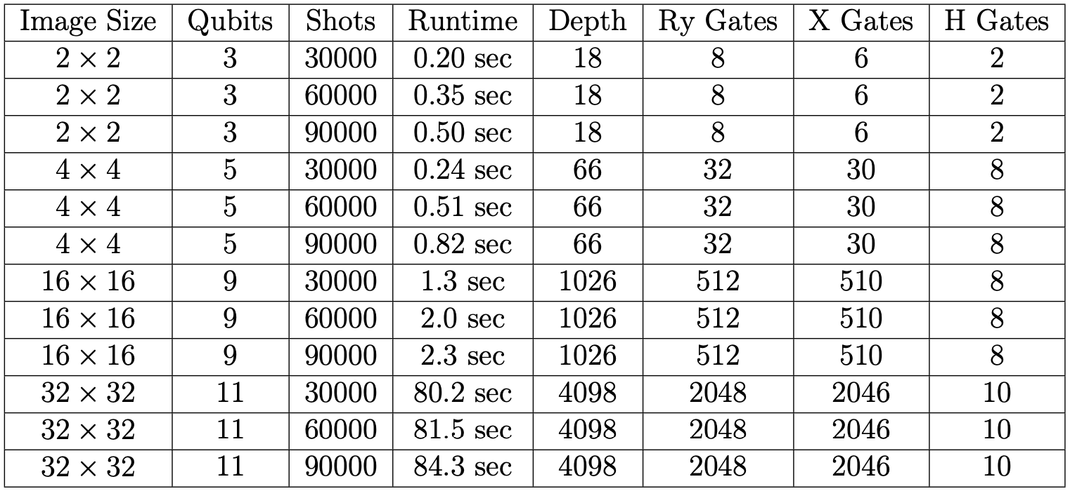
RESULT AND ANALYSIS

Slide 14
CONCLUSION
This study introduces depth-optimized and time-efficient classical-to-quantum (C2Q) data encoding using FRQI encoding and quantum-to-classical (Q2C) data decoding using the Quantum Haar Transforms with one-stage parallel circuit methodology. The corresponding quantum circuits are presented and experimental evaluations are conducted using IBM Quantum and PennyLane's Lightning Qubit system. Methods for quantitative analysis are implemented, and the runtime and circuit depth variations are analyzed for different image sizes. Experimental results demonstrate the effectiveness of the proposed methods, improving the time efficiency of the C2Q and Q2C processes.

Slide 15
FUTURE WORK
Our future research will focus on exploring further optimizations for the proposed C2Q and Q2C methods including distributed amplitude and angle encoding, NEQR encoding, and many other encoding and decoding techniques, to explore more about the use of Quantum Haar Transforms in other applications, such as well as investigating quantum error correction techniques to improve the fidelity of the output images.

Slide 16
References
Yi N. Mahmud et al., "Efficient Data Encoding and Decoding for Quantum Computing," 2022 IEEE International Conference on Quantum Computing and Engineering (QCE), Broomfield, CO, USA, 2022, pp. 765-768, doi: 10.1109/QCE53715.2022.00110.
N. Mahmud, A. MacGillivray, M. Chaudhary and E. El-Araby, "Decoherence- Optimized Circuits for Multidimensional and Multilevel-Decomposable Quan- tum Wavelet Transform," in IEEE Internet Computing, vol. 26, no. 1, pp. 15-25, 1 Jan.-Feb. 2022, doi 10.1109/MIC.2021.3133845.
Le, P.Q., Dong, F. Hirota, K. A flexible representation of quantum images for polynomial preparation, image compression, and processing operations. Quan- tum Inf Process 10, 63–84 (2011)
Fijany, A., and C. Williams. "Quantum wavelet transform fast algorithm and complete circuits (1998)." arXiv preprint quant-ph/9809004.
H. Ohnishi, H. Matsueda and L. Zheng, "Quantum wavelet transform and matrix factorization" in Proc. IEEE Int. Quantum Electron. Conf., pp. 1327-1328, 2005

Slide 17
Thank you!

